Slide 1
Parallel Implementation of Median Filtering
- Prakhar Jain

Slide 2
Motivation
An image consists of thousands of pixels and better the quality of the image, more the number of pixels.
Processing each and every pixel is a time consuming task if done sequentially which ultimately results in slow loading of an image.
Comparatively, parallelization can help processing the image very quickly.
Application: NASA captures very dense images of clusters of stars which the scientists need to study. Due to space noise, it is necessary to filter/smooth the image in order to remove/reduce the noise so the significant areas of the image are highlighted.

Slide 3
How do we filter the image using Median Filter?

Slide 4
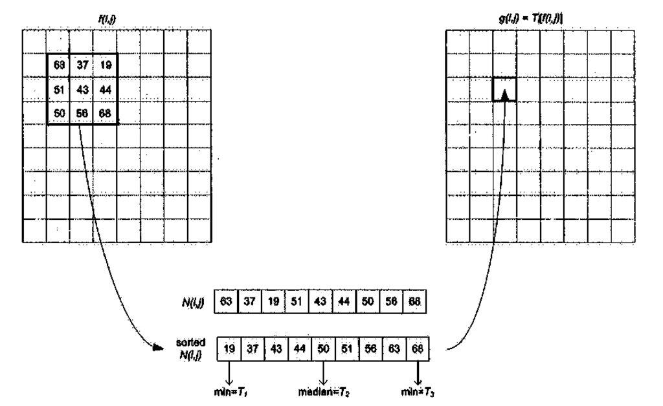

Slide 5
Serial Implementation

Slide 7
Parallel Implementation

Slide 9
Outputs

Slide 10
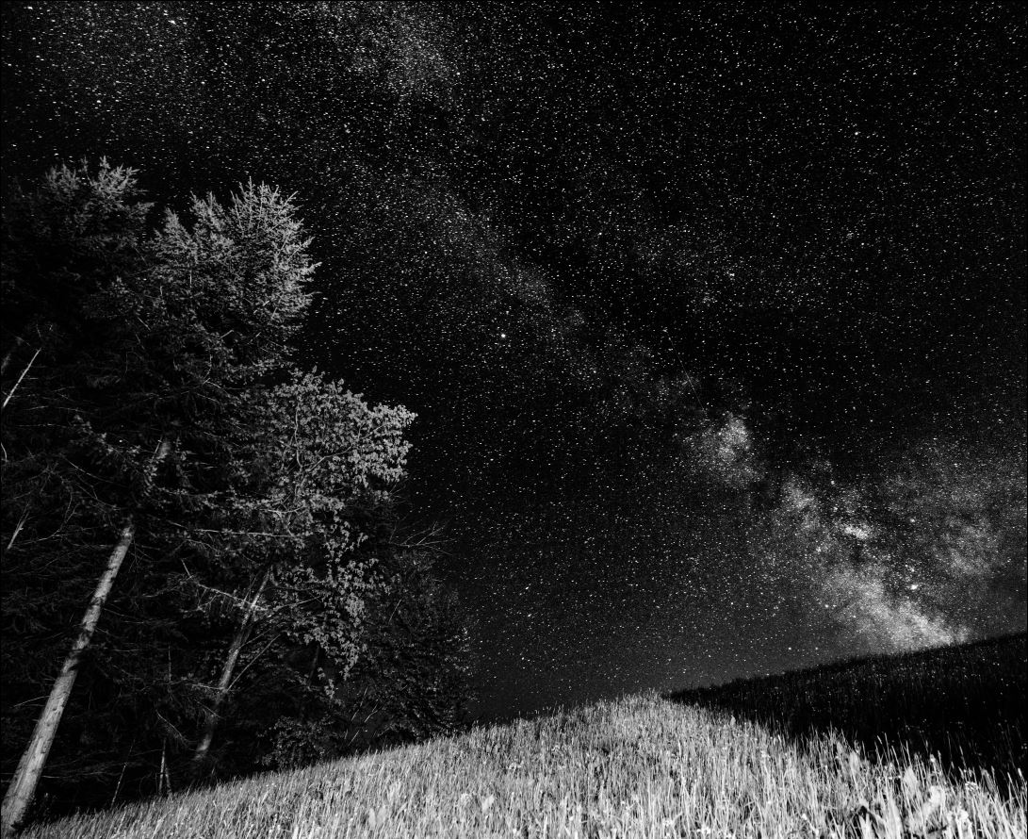
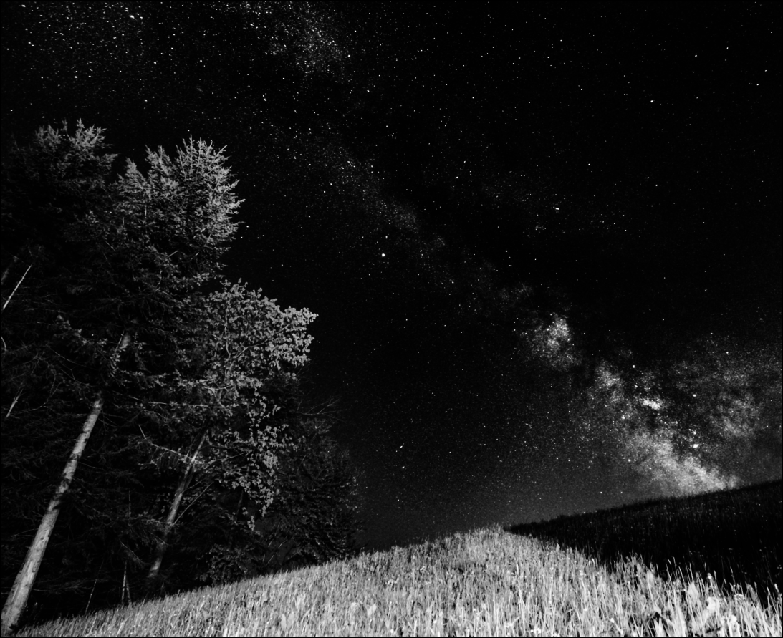
Window size = 9; Schedule: Static, chunk size = 1; No. of Threads = 16
Input_Image3.pgm
MedianFiltered_Image.pgm

Slide 11
Performance Analysis

Slide 12
Execution time vs Schedules for different number of threads

Slide 13
Serial Execution time Vs Best-Case Parallel Execution time

Slide 14
Speedup & Efficiency

Slide 15
Numactl
The parallel execution time for Input_Image3.pgm with the best schedule(static: chunk size 1 and 16 number of threads) is 92.773567 secs.
Using ‘numactl --membind=1 ./median_parallel.sh’, there is a further 1.21% reduction in the execution time.
The execution time with numactl is 91.652204

Slide 16
Scalability
We can see that the efficiency is almost constant and there is no significant variation as the image size increases.
That is, the efficiency does not change as the data set/size increases.
Thus, the parallelized program can be said to be weakly scalable.

Slide 17
Conclusion
For the proposed parallel program for median filtering of an image, the optimum schedule for execution is Static Scheduling with chunk size 1
The execution time goes on decreasing with the increasing number of threads till 16 threads. Beyond 16, the execution time begins to increase due to increased overheads
The guided and auto schedules proved to be worst for the given parallel program

